Slide 1

Breast Cancer Detection and Analysis
FINAL PROJECT PROPOSAL
TEAM 5
AKILAN RAJENDIRAN
DHRUV KANAKIA
UNDER THE GUIDANCE OF:
Prof. SRIKANTH KRISHNAMURTHY

Slide 2
FACTS ABOUT BREAST CANCER
Breast cancer is a disease in which malignant (cancer) cells form in the tissues of the breast.
One in eight women in the United States will be diagnosed with breast cancer in her lifetime.
Breast cancer is the most commonly diagnosed cancer in women.
Breast cancer is the second leading cause of cancer death among women.
Each year it is estimated that over 246,660 women in the United States will be diagnosed with breast cancer and more than 40,000 will die.
Although breast cancer in men is rare, an estimated 2,600 men will be diagnosed with breast cancer and approximately 440 will die each year.
On average, every 2 minutes a woman is diagnosed with breast cancer and 1 woman will die of breast cancer every 13 minutes.
Over 2.8 million breast cancer survivors are alive in the United States today.

Slide 3
PROBLEM STATEMENT
Research says that many women have breast cancer from young age and due to late detection, it gets difficult to cure it in the later stages.
After a scan, if oncologist finds a lump in a breast it is difficult task for oncologist to figure out if the lump is benign or malignant.
Our challenge here is to develop a Data Science application that will help women to calculate or assess their risk of getting BREAST CANCER and for the doctors based on the analysis of cancer cells determine if it is benign or malignant
A prediction model based on the input parameters would predict the probability of getting breast cancer.
A classification model for oncologist that would classify the tumor as BENIGN/MALIGNANT based on the input parameters.

Slide 4
PROPOSED APPROACH
PART 1: PARSING FILES AND HANDLING MISSING DATA
We are using two data sets for the application:
  http://www.bcsc-research.org/rfdataset/dataset.html
  https://archive.ics.uci.edu/ml/datasets/breast+cancer+wisconsin+(original)
The goal is to use the first link for prediction of BREAST CANCER and the second link for classification of lump as BENIGN/MALIGNANT.
PART 2: MACHINE LEARNING: PREDICTION AND CLASSIFICATION:
Following steps will be covered:
R/Python script for variable selection
R script to execute various classification and prediction model and select the best model based on the accuracy
Implement and Deploy the best model on Azure Machine Learning Studio
Create API and use this API to deploy the model on cloud platform
PART 3: DOCKERIZING AND AUTOMATING THE PROCESS USING AIRLOW
DOCKER images OF THE PYTHON/R script will be created
AIRFLOW to automate the images so that the application runs in one click.

Slide 5
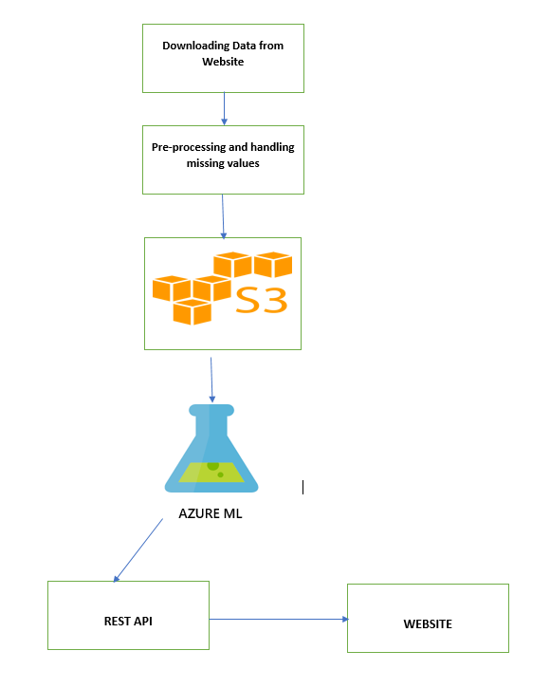
WORKFLOW:

Slide 6
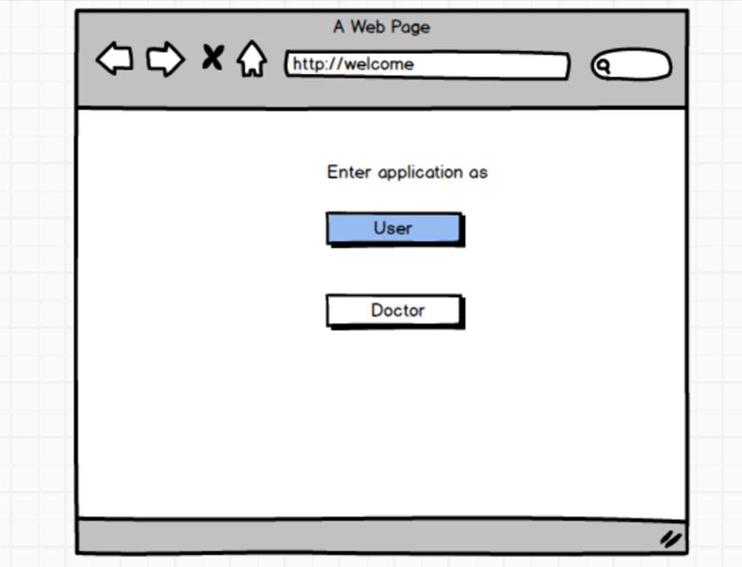
SAMPLE UI

Slide 7
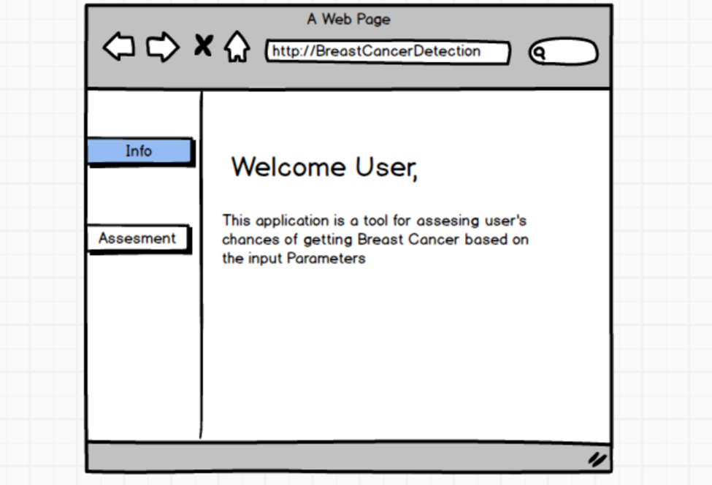
WELCOME PAGE

Slide 8
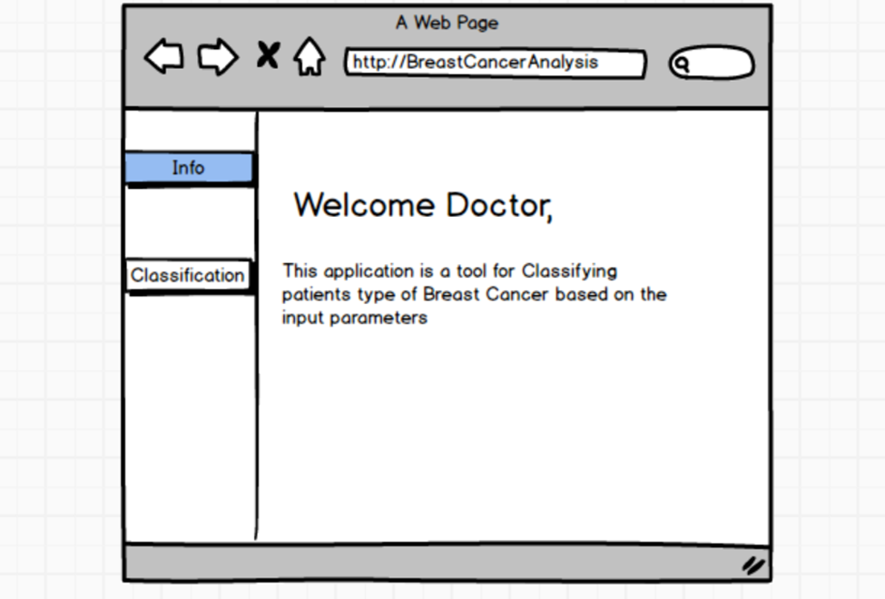
DOCTOR’s Page

Slide 9
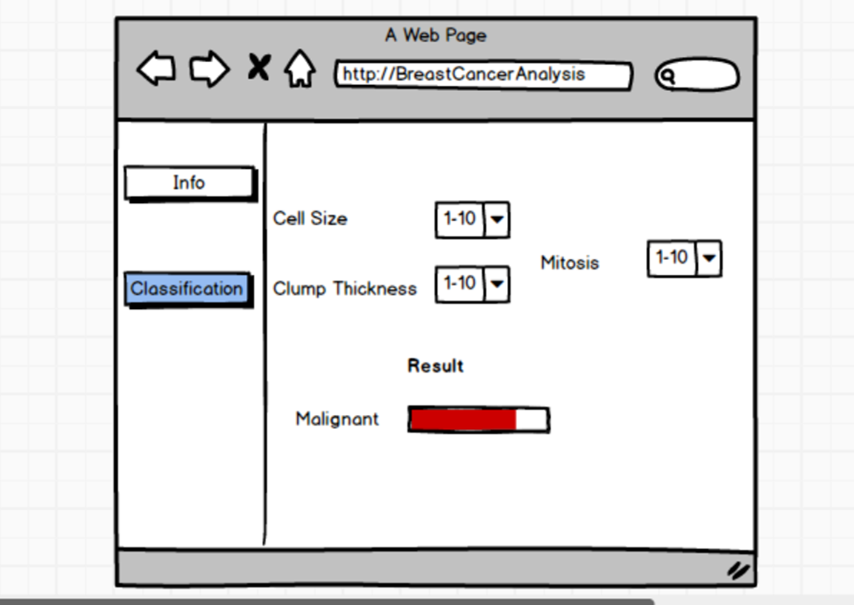
CLASSIFICATION MOCK SCREEN

Slide 10
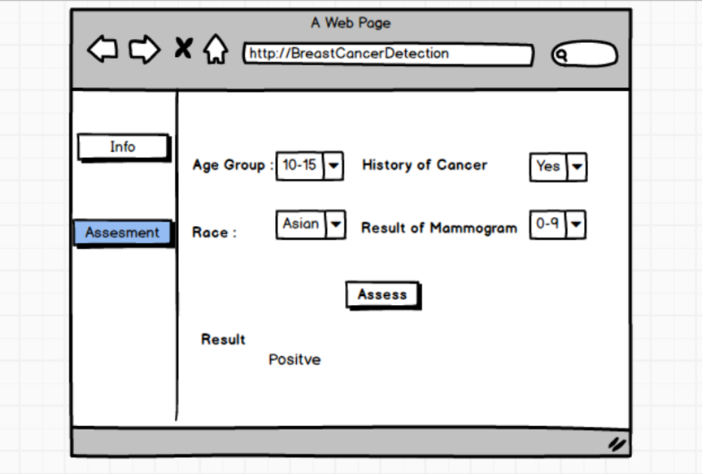
ASSESSMENT MOCK SCREEN

Slide 11
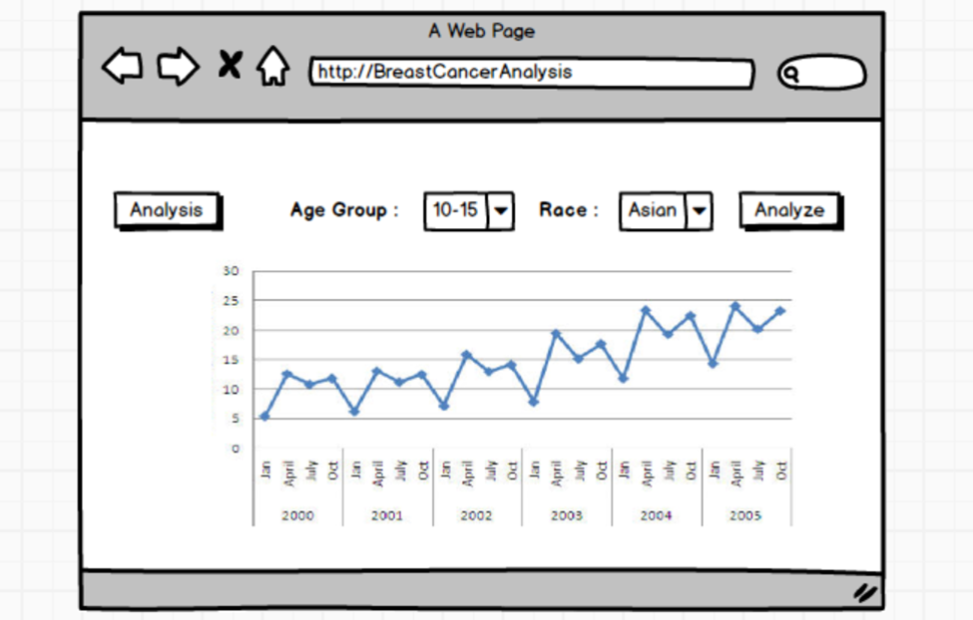
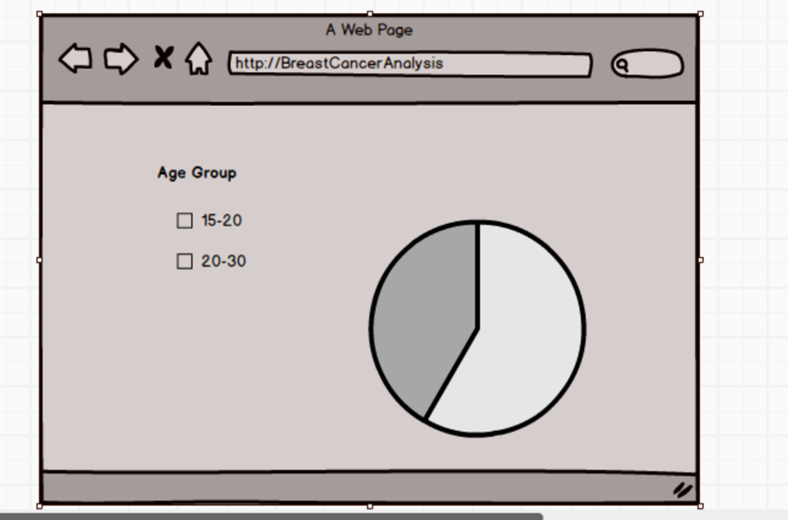
DATA ANALYSIS

Slide 12
References
http://www.bcsc-research.org/
https://archive.ics.uci.edu/ml/datasets/breast+cancer+wisconsin+(original)
https://sciencelife.uchospitals.edu/2017/05/04/large-data-set-brings-precision-to-breast-cancer-diagnosis-and-care/
https://www.cdc.gov/cancer/breast/statistics/state.htm
http://rexa.info/paper/56eb4e64499baa9ef620d2aeb5383e1739a2e6e3

Slide 13
THANK YOU

